Slide 1
Powershell Task Automation
Knowledge Sharing
Bryndell Torio, D&D
2022.12.11

Slide 2


Objective
To generate interest in using command line tools such as PowerShell to enhance your workflow.
For you to be able to create your own custom PowerShell functions.
For you to be able to create your own scripts to automate small “boring” repetitive tasks.

Slide 3

Introduction
PowerShell is a task automation and configuration management program from Microsoft, consisting of a command-line shell and the associated scripting language. Initially, a Windows component only, known as Windows PowerShell, it was made open-source and cross-platform on 18 August 2016 with the introduction of PowerShell Core. The former is built on the .NET Framework and the latter on .Net Core.

Slide 4
Operating System
USER INPUT
Hardware
Computer Hardware includes the physical parts of a computer, such as the case, central processing unit, random access memory, monitor, mouse, keyboard, computer data storage, graphics card, speakers and motherboard.
Kernel
The kernel is a computer program at the core of a computer’s operating system and generally has complete control over everything in the system.
Shell
a Shell is a computer program that exposes an operating system's services to a human user or other programs. In general, operating system shells use either a command-line-interface(CLI) or graphical user interface(GUI).
SHELL
KERNEL
HARDWARE

Slide 5
Types of Linux Shells
The Bourne Shell – Stephen Bourne at bell labs 1979
BASH[Bourne Again Shell] – Brian Fox 1989
CSH[The C Shell] – Bill Joy 1970
TCSH[TENEX C Shell] – Ken Greer 1981
KSH[The Korn Shell] – David Korn at bell labs 1980
ZSH[The Z Shell] – Paul Falstad at Princeton University 1990
FISH[Fish Shell] – Axel Liljencrantz 2005

Slide 6
Learning Triangle
10% Lecture
20% Reading
30% Audiovisual
50% Demonstration
75% Practice Doing
90% Teach Others

Slide 7
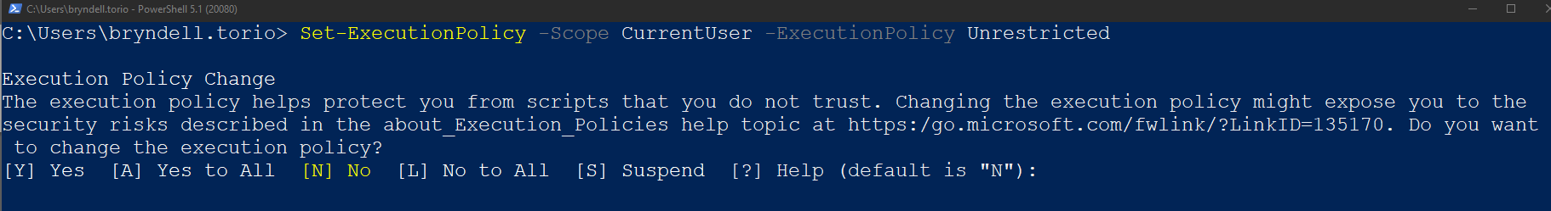
PowerShell Setup and Installation
Set execution policy to be Unrestricted.
Set-ExecutionPolicy –Scope CurrentUser –ExecutionPolicy Unrestricted
Installing PowerShell 7
The recommended way to install PowerShell 7 is by using the winget command.
Winget search powershell
Winget install –-id Microsoft.PowerShell

Slide 8
Configuration
The configuration file of PowerShell 7 is located at
$HOME/Documents/PowerShell/Microsoft.PowerShell_profile.ps1
For Windows PowerShell version 5.1 the default location is
$HOME/Documents/WindowsPowerShell/Microsoft.PowerShell_profile.ps1

Slide 9
Top PowerShell commands that you need to know.
Get-ChildItem
Set-Location
New-Item
Remove-Item
Move-Item
Copy-Item
Get-Content
Test-Path
Start-Process
Get-Alias
Get-Help
Cheat Sheet
PowerShell | Linux
Get-ChildItem | ls
Set-Location | cd
New-Item | touch
Copy-Item | cp
Move-Item | mv
Remove-Item | rm
Get-Content | cat
Start-Process | open
Get-Help | --help parameter

Slide 10
Top PowerShell commands that you need to know.
Get-ChildItem
The `Get-ChildItem` cmdlet gets the items in one or more specified locations. If the item is a container, it gets the items inside the container, known as child items. You can use the Recurse parameter to get items in all child containers and use the Depth parameter to limit the number of levels to recurse.
Get-ChildItem –Path $HOME –Name
Set-Location
The `Set-Location` cmdlet sets the working location to a specified location. That location could be a directory, a subdirectory, a registry location, or any provider path.
Set-Location $HOME

Slide 11
Top PowerShell commands that you need to know.
New-Item
The `New-Item` cmdlet creates a new item and sets its value. The types of items that can be created depend on the location of the item. For example, in the file system, `New-Item` creates files and folders. In the registry, `New-Item ` creates registry keys and entries.
New-Item –Name <File name> -Path <Location> -ItemType Directory
Remove-Item
The `Remove-Item` cmdlet deletes one or more items. Because it is supported by many providers, it can delete many different types of items, including files, folders, registry keys, variables, aliases, and functions.
Remove-Item <File name>

Slide 12
Top PowerShell commands that you need to know.
Move-Item
The `Move-Item` cmdlet moves an item, including its properties, contents, and child items from one location to another location. The locations must be supported by the same provider.
Move-Item –Path <File name.extension> –Destination <Location>
Copy-Item
The `Copy-Item` cmdlet copies an item from one location to another location in the same namespace. For instance, it can copy a file to a folder, but it can’t copy a file to a certificate drive.
Copy-Item file1.txt file2.txt –Path <Desired Location>

Slide 13
Top PowerShell commands that you need to know.
Get-Content
The `Get-Content` cmdlet gets the content of the item at the location specified by the path, such as the text in a file or the content of a function. For files, the content is read one line at a time and returns a collection of objects, each of which represents a line of content.
Get-Content <File name.extension>
Test-Path
The `Test–Path` cmdlet determines whether all elements of the path exist. It returns $Tue if all elements exist and $False if any are missing. It can also tell whether the path syntax is valid and whether the path leads to a container or a terminal or leaf element. If the Path is whitespace or empty string, then $False is returned. If the Path is $null, array of $null or empty array, a non-terminating error is returned.
Test-Path <File name.extension>

Slide 14
Top PowerShell commands that you need to know.
Start-Process
The `Start-Process` cmdlet starts one or more processes on the local computer. By default, `Start-Process` creates a new process that inherits all the environment variables that are defined in the current process.
Start-Process <Application Name>
Get-Alias
The `Get-Alias` cmdlet gets the aliases in the cyrrent session. This includes build-in aliases, aliases that you have set or imported, and aliases that you have added to your PowerShell profile.
Get-Alias

Slide 15
Top PowerShell commands that you need to know.
Get-Help
The `Get-Help` cmdlet displays information about PowerShell concepts and commands, including cmdlets, functions, Common Information Model(CIM) commands, workflows, providers, aliases, and scripts.
Get-Help <Command> -Examples

Slide 16
Custom Function
Naming
When naming your functions in PowerShell, use a Pascal case name with an approved verb and singular noun. I also recommend prefixing the noun.
For example: <ApprovedVerb>-<Prefix><SingularNoun>
PascalCasing
camelCasing
Basic Function
function Print-Text {
param([string]$Name)
process {
if ($Name –eq “Check”) {
echo “Checked!” }
else { echo “ You entered: $Name”
} } }

Slide 17
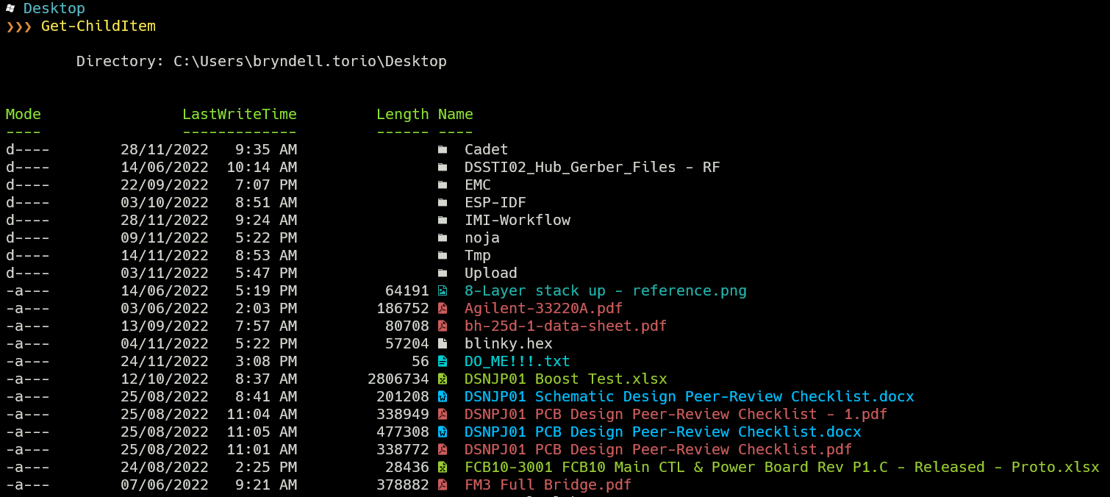
Building your own custom terminal

Slide 18
Summary
Setup PowerShell
Useful PS commands
Building our own custom functions

Slide 19
“Programming is a skill best acquired by practice and example rather than from books.”
Alan Turing

